Slide 1
Modele Statistice Liniare si Neliniare Applicate
Introduction

Slide 2
Overview:
Objective
Syllabus
Modeling
Applied modeling
Regression

Slide 3
Course Objective
MAIN objective: Develop complex and reliable models
Focused objective: regression
Examine assumptions & their impact
Nonlinear modeling
Mixed models
Generalized linear models

Slide 4
Syllabus
Meeting time: Wed 17:00: - 19:50
Classroom: #1
Assignments: 7 35%
Midterm 20%
Final 20
Project 25%

Slide 5
Grades and Other
Expected student conduct
Academic integrity
Students with Disabilities
A > 93 | C+ 77 – 80
A- 90 – 93 | C 70 – 77
B+ 87 – 90 | C- 65 – 70
B 83 – 87 | D 60 – 65
B- 80 - 83 | F < 60

Slide 6
Supporting Materials
Kutner, M.H., C.J. Nachtsheim, J. Neter, and William Li. 2005. Applied Linear Statistical Models. 5th Ed. McGraw-Hill
J.K. Vanclay. 1994. Modelling Forest Growth and Yield: Applications to Mixed Tropical Forests. Online free
Venables, W.N., Smith, D.M., and the R Core Team, 2015. An Introduction to R. Online free

Slide 7
Project
Real problem
From your research
From given data
Selection of the project: end of 2nd week
Stand alone manuscript
All sections of a manuscript
Properly written

Slide 8
FOUNDATION

Slide 9
Modeling
What is a model?
a system or thing used as an example to follow or imitate (Dictionary. Com)
a simplified description, especially a mathematical one, of a system or process, to assist calculations and predictions
Applied model: models focused on a particular aspect of reality, life forest
A mathematical or statistical representation of a relationship between variables which may represent processes or attributes of interest

Slide 10
Applied modeling
Model: functional and stochastic (Korzukhin et al, 1996)
Functional (process) → causal
Stochastic (statistical) → empirical
Choice:
philosophical (gnoseologic)
practical

Slide 11
Models

Slide 12
Modeling choice

Slide 13
Modeling choice (2)
Stochastic – no relationship
Functional: logistic model
$\frac{dN}{dt}=\frac{rN(K−N)}{K}$→$\frac{dx}{dt}=rx(1−x)$
A little bit of history on logistic equation
Von Neumann suggested using the logistic map with parameter 4 as a random number generator
Foundation of chaos theory

Slide 14
Statistics History
Sampling theory
Formal birth: hypothesis testing
Method to decide whether the data provides support a particular statement (hypothesis)
Inference based on observations alone <XVIII
Laplace and Arbuthnot credited with mentioning hypothesis testing
Sir Fisher: the creator of null hypothesis
H0: the observed differences between the data and hypothesis are due to chance alone
Hypothesis testing (XX century):
Jerzy Newman and Egon Pearson

Slide 15
Objectives of applied modeling
Find relationships between response variable and predictor variables
Describe variables dependencies
Relate measurements to meaningful attributes
Models: describe or predict
Our goal is to develop parsimonious models
Simple
Correct
Robust

Slide 16
Modeling Steps
Steps
Visual assessment of data
Develop tentative models
Select an appropriate model
Validate the model
Irrespective the model: functional/stochastic
This class focused on regression → stochastic

Slide 17
Regression
Francis Galton coined the term regression 1885
Height of humans
Nature 1877 “Typical laws of heredity”: reversion
Darwin’s cousin
Followed by Pearson (γ² test) and Fisher (H0, ML, F)
An equation:
$Y=f\left(X\right)+$ε
Y – dependent (predicted) variable
X – independent (predictor) variables
ε – error / residual (the unknown)
If f is linear → linear regression

Slide 18
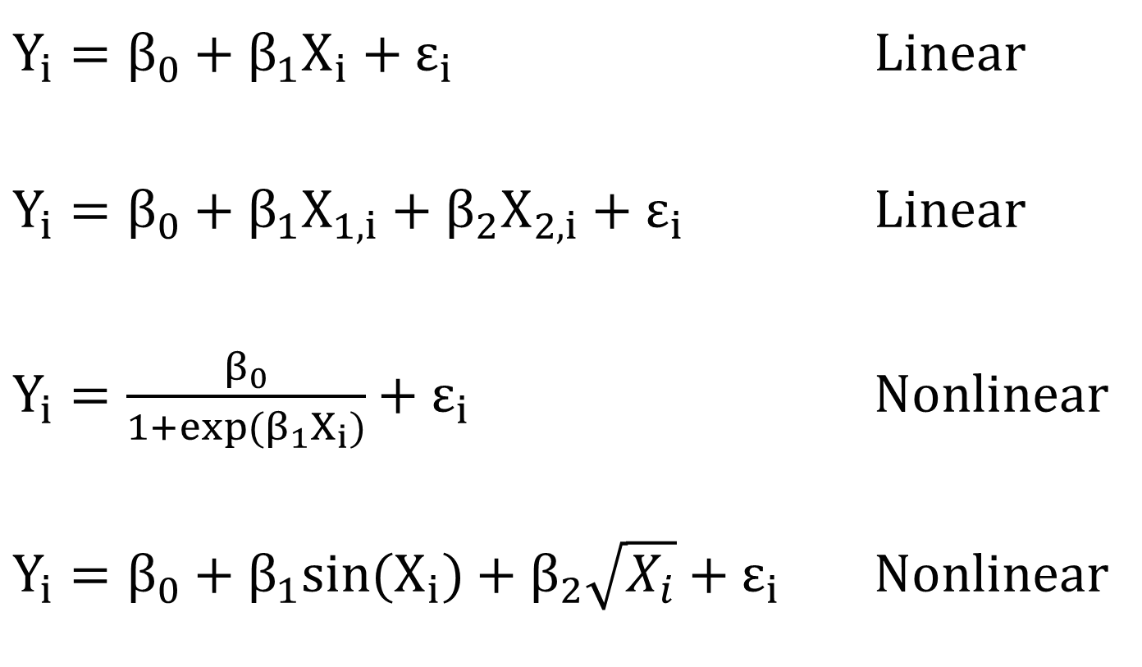
Regression
$Y_{i}=β_{0}+β_{1}X_{i}+ε_{i}$ Linear
$Y_{i}=β_{0}+β_{1}X_{1,i}+β_{2}X_{2,i}+ε_{i}$ Linear
$Y_{i}=\frac{β_{0}}{1+exp⁡(β_{1}X_{i})}+ε_{i}$ Nonlinear
$Y_{i}=β_{0}+β_{1}{sin(X}_{i})+β_{2}\sqrt{X_{i}}+ε_{i}$ Nonlinear

Slide 19
Regression – Matrix Algebra
$$Y_{i}=β_{0}+β_{1}X_{1,i}+β_{2}X_{2,i}…+β_{n}X_{n,i}+ε_{i}$$
$$Y=Xβ+ε$$
$Y$ is a vector of responses
$X$ is called design matrix
$β$ is parameter vector
$ε$ is error vector

Slide 20
Simple Linear Regression (SLR)
SLR describes one variable with another variable
$$Y_{i}=β_{0}+β_{1}X_{i}+ε_{i}$$
$Y_{i}$ = dependent variable,
$X_{i}$= independent variable,
$β_{0},β_{1}$= regression parameters,
$ε_{i}$= random error
The term linear refers to the fact that all variables have the exponent 1

Slide 21
SLR
Two main questions:
What are the parameters?
How good is the model, in this case SLR?
Parameter estimation:
Simple for linear relationships
“Goodness” of model → it’s complicated
True model: impossible to know
Assess adequacy → 2 parts
Overall
Correctness

Slide 22
SLR – Parameter estimation
Least Square methods
Minimizes the errors → Gauss-Markov Theorem
BLUE: best linear unbiased estimator (min. variance)
The oldest
Roger Cotes (1722) review Newton’s Principia
Legendre (1805) and Gauss (1809)
Maximum likelihood
Maximizes the probability to happen
Pearson and Filon (1898)
Fisher (1922)

Slide 23
SLR - Goodness
Overall
“A theory is only as good as its assumptions” Maurice Allais - Nobel Prize in Economics
Garbage in – Garbage out
SLR assumptions
Model is linear (this is the big one)
The residuals are independent
The residuals have the same variance across
The residuals are normally distributed
Unchecked assumption: There are no measurement errors

Slide 24
SLR assumptions - revisited
Model is linear
In actuality, it is impossible to know
The residuals are independent
Crucial for subsequent computations
The residuals have same variance across X
The residuals are normally distributed
$ε_{i}$~iid N(0, $σ^{2}$)

Slide 25
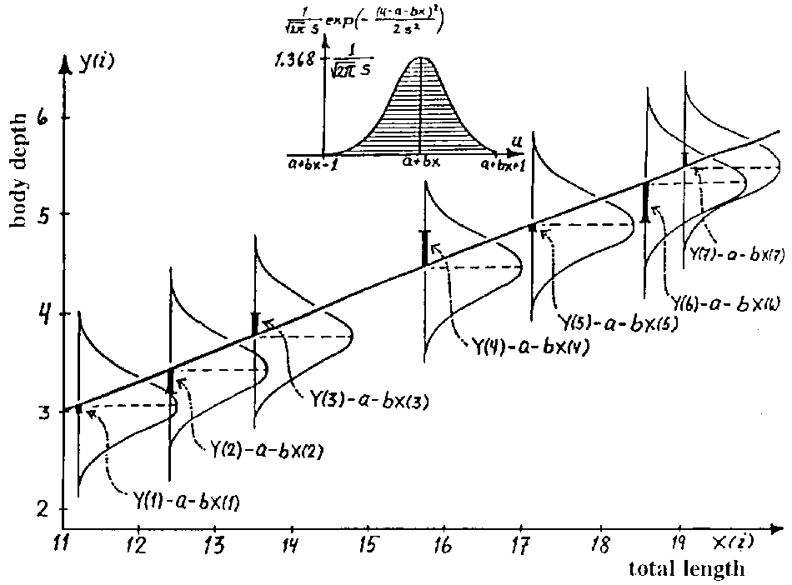
Residuals assumptions

Slide 26
Summary
Modeling
Functional vs. stochastic
Applied models
Regression
Simple linear regression

Slide 27
Notes:
Thank you for your attention.

