Slide 1
Modele Statistice Liniare si Neliniare Applicate
Basic Statistics Review

Slide 2
Overview
Random Variable
Normal distribution
Central Limit Theorem
Confidence Interval
Hypothesis Testing

Slide 3
Random Variable

Slide 4
Mundane definition
Variabla aleatoare este o caracteristica de interes a unei populatii
Exemple
Inaltimea arborilor dintr-o padure
Greutatea pestilor dintr-un lac
Numarul de sateliti ai unei planete
Numarul de accidente pe o sosea
Aria unui incendiu de padure

Slide 5
Variabla Aleatoare
O variabila aleatoare reala pe spatiul de probabilitate $(Ω, ℱ,P)$este o functie
X : Ω -> R masurabila in raport cu σ-algebrele corespunzatoare ($ℱ$ pe Ω, respectiv σ-algebra Boreliana ℬ pe R).
Acesta inseamna
$$X^{−1}\left(B\right)=\left\{ω∈Ω|X(ω)∈B\right\}∈ℱ$$
pentru orice multime Boreliana $B∈ℬ$

Slide 6
Key concepts
Spatiu de probabilitate
Spatiu masurabil
Sigma algebra
Sigma algebra Boreliana

Slide 7
Sigma algebra
Fie o multime nevida $Ω≠∅$,
o σ–algebra pe Ω este o familie nevida
$ℱ⊂P\left(Ω\right)=\left\{A|A⊂Ω\right\}$ de submultimi a lui Ω, care are doua proprieti:
1) $ℱ$ este ınchisa la complementara,
A ∈ $ℱ$ ⇒ non A ∈ $ℱ$
2) $ℱ$ este ınchisa la reuniuni numarabile
$$A_{1},A_{2},…, A_{n}∈ℱ⇒\bigcup_{i=1}^{n}{A_{i}∈ℱ}$$

Slide 8
Sigma algebra Boreliana & spatiu masurabil
Sigma algebra Boreliana pe R
$ℬ=ℬ\left(R\right)=σ −algebra multimilor B din R$
$$cu propretatea B⊂R si B multime deschisa$$
Spatiu masurabil este perechea $\left(Ω,ℱ\right)$ unde
Ω este o multime nevida pentru care s-a definit o σ–algebra $ℱ$.

Slide 9
Masura de probabilitate
O masura de probabilitate pe spatiul masurabil (Ω, $ℱ$) este o functie
P : $ℱ$→ [0,∞) care are doua proprietati:
P(Ω) = 1
Pentru orice submultimi disjuncte doua cite doua A₁, A₂ . . ∈$ℱ$
$$P\left(\bigcup_{i=1}^{∞}{A_{i}}\right)=\sum_{i=1}^{∞}{P(A_{i})}$$

Slide 10
Spatiu de probabilitate
Un spatiu de probabilitate este tripletul (Ω, $ℱ$, P) care are their proprietati:
Ω ∅
$ℱ$ este o σ–algebra a lui Ω
P este o masura de probabilitate pe spatiul masurabil (Ω, $ℱ$)

Slide 11
Functia de distributie - formal
Functia de distributie a variabilei aleatoare X este F : R → R definite de relatia
$$F\left(x\right)=P(X≤x)$$
Observatie: probabilitatea ca variabila X sa fie in intervalul (a, b] este
$$P\left(X∈\left(a,b\right]\right)=P\left(a<X≤b\right)=F\left(b\right)−F(a)$$

Slide 12
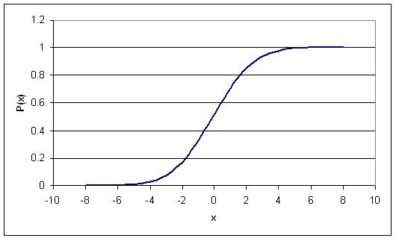
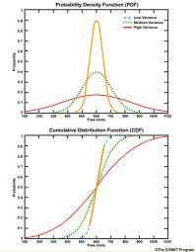
Distribution function - simplified
cumulative density function, or cdf
cdf is symbolized by capital letters: F, G
cdf=F(x)=P(X<=x)
The probability of a continuous RV to be within a narrow interval is called probability density function, or pdf.
Symbolized with small caps, f

Slide 13
Continuous distributions
Uniform distribution
Normal distribution
t-distribution
Chi-square
F-distribution
Weibull distribution
Gamma distribution
Beta distribution

Slide 14
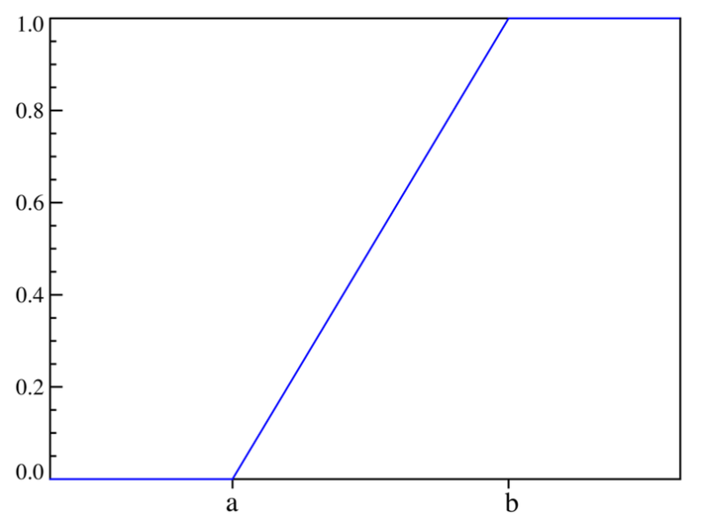
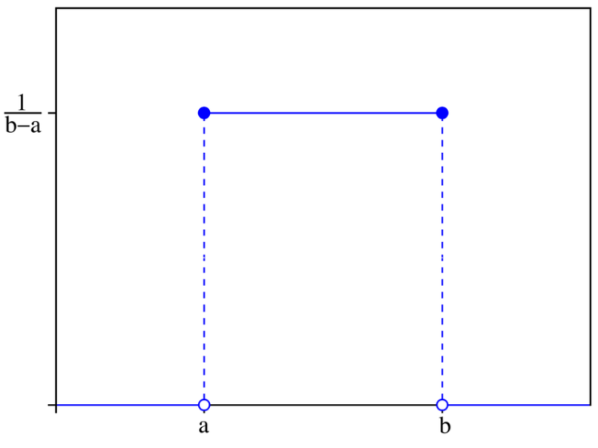
Uniform distribution
A continuous RV has a uniform distribution if its pdf is constant over an interval
CDF
PDF

Slide 15
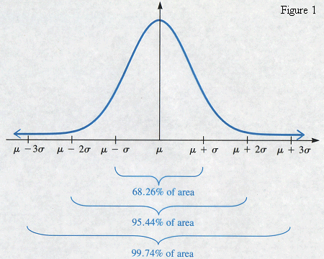
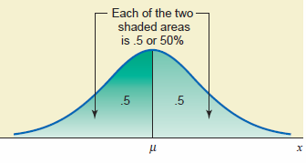
Normal distributions
Continuous distribution
The values of the random variable are real numbers
Each value of the RV has a probability of occurrence
Symmetric
Mean = median = mode
Unimodal
Bell-shaped
Area under curve = 100%

Slide 16
Normal distribution
the shape and position of the normal distribution depends on 2 parameters:
the mean of the distribution defines the position
the standard deviation defines how the observations are spread

Slide 17
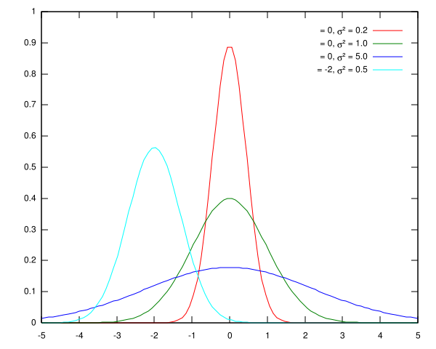
Standard normal distribution
Variety of normal distribution
Standardization
Standard normal distribution

Slide 18
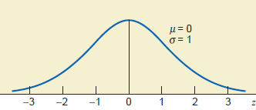
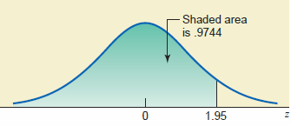
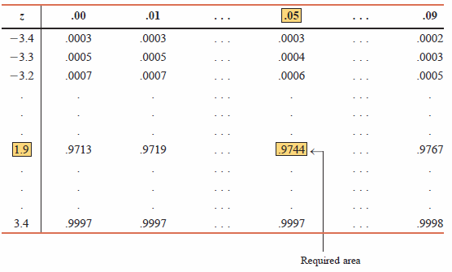
Standard Normal distribution
The units marked on the horizontal axis of the standard normal curve are denoted by z and are called the z values or z scores

Slide 19
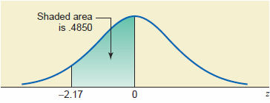
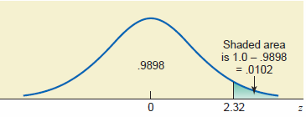
Standard normal distribution
P(-2.17<z<0)=
=P(z<0) - P(z<-2.17) =
=0.500-0.015=0.485
P(z>2.32)=1-P(z<2.32)=
=1-0.9898=0.102
Remember:
P(z≤a) = P(z<a) as P(z=a)=0

Slide 20
Central Limit Theorem

Slide 21
Population distribution
Population distribution: probability distribution derived from ALL elements of the population
Using the population distribution two parameters are commonly computed:
Mean
Variance
Note: A population parameter is always constant

Slide 22
Sampling distribution
Sample distribution: probability distribution of a subset of the element of the population
Same statistics are computed for the sample:
Mean:
Variance: s²
Note: Because two samples are different, the two statistics differ from sample to sample
Sample mean acts as random variable
Probability distribution of a sample statistic is called SAMPLING DISTRIBUTION

Slide 23
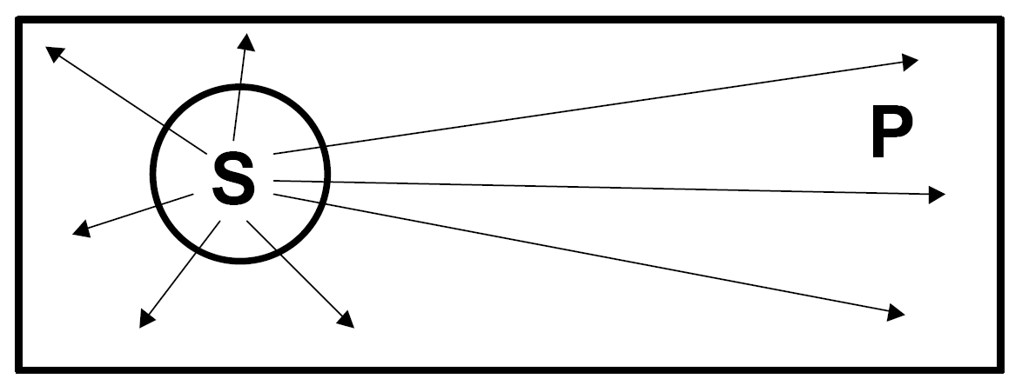
Sampling distribution
OBJECTIVE: Inference from sample to population
Population described by probability distribution
Sample “approximate” (represent) the population

Slide 24
Sampling & nonsampling errors
Sampling error is the difference between the value of a sample statistic and the value of the corresponding population parameter
NOTE: sampling error occurs because of chance
Nonsampling errors are errors that occur in the collection, recording, and tabulation of data

Slide 25
Distribution of sample Mean
Statistics: descriptors of the sample
Mean of the sample distribution of $\overline{x}$ is $μ_{\overline{x}}$
Standard deviation of $\overline{x }$ is $σ_{\overline{x}}^{}$
Theorem: The mean of the sample distribution of $\overline{x}$is the mean of the population μ
Theorem: The variance of the distribution of the sample distribution of $\overline{x }$is

Slide 26
Central Limit Theorem
For large sample sizes (especially if n > 30), the sampling distribution of is approximately normal irrespective of the shape of the distribution from which the sample is drawn.
The mean and standard deviation of the sampling distribution of are:

Slide 27
Central Limit Theorem
CLT – most important result from basic statistics
Properties
CLT is valid regardless the distribution of the variable
The mean of the samples = mean of the population
The standard deviation of the means is
The sample is taken with replacement
Standard error = stand. Dev. of the sample means

Slide 28
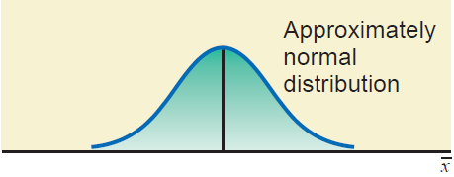
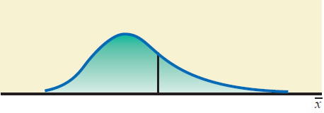
Central limit theorem

Slide 29
Central Limit Theorem Usage
The CLT allows us to answer questions about sample means in the same way we answered questions about individual values
If the means are NOT distributed with mean 0 and variance 1 then find probabilities of means with a z-transformation

Slide 30
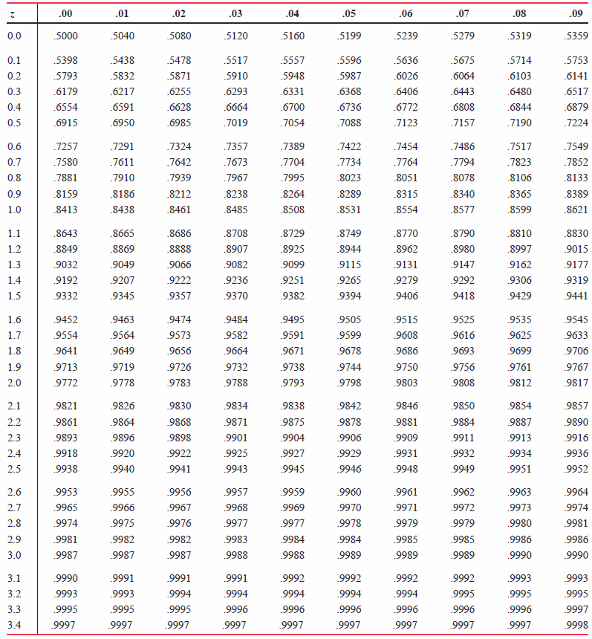
Standard Normal distribution

Slide 31
CLT – EXAMPLE
The average grade for the first assignment in MATE 503 was 85% and the variance was 56. For a sample of size 3 (assume that students worked in groups of three) find the probability that:
The mean of the sample is less than the mean of the class.
The mean of the sample is A (grade larger than 95%)
The mean of the sample is B (grade between 85-95%)

Slide 32
CLT – Example
Sample mean = μ =
Standard error of the mean = =
P(sample mean ≤ 85)= ………
P(sample mean ≥ 95%) = ………
P(85 ≤ sample mean ≤ 95) = …………..

Slide 33
Confidence
Interval

Slide 34
Estimation
Estimation: process of determining the value of a population parameter from information obtained from the sample statistic
Point estimate: a specific numerical value of a parameter
Population mean estimated by sample mean
Why not median or mode? More variable than mean
Estimator: sample statistic (such as mean or variance) used to estimate population parameter (the corresponding mean and variance)

Slide 35
Estimator’s Properties
Unbiased
The expected value of the sample’s estimate is equal to the parameter being estimated
Consistent
The increase in sample size produces better estimates
Efficient
Among all the statistics that can be used to estimate a population parameter the efficient estimator has the smallest variance

Slide 36
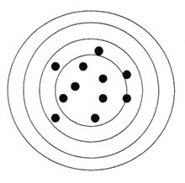
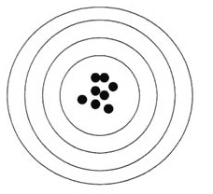
allegory
Biased but efficient estimator
Unbiased but Inefficient estimator
Unbiased and efficient estimator

Slide 37
Interval estimate
How good is a point estimate?
Is the average height of a forest 15.1’ or 15.2’?
Is there any difference between 15.1 ‘ and 15.2’?
Instead of assigning a single value to a population parameter, an interval is constructed around the point estimate, and then a probabilistic statement that this interval contains the corresponding population parameter is made.
Interval estimate: range of values used to estimate a parameter
It has a lower and upper bound/limit
The interval CAN or CANOT contain the true value of the parameter

Slide 38
Confidence level
Estimated interval is an interval is constructed around the sample based point estimate, and it is accompanied by a statement of the likelihood that this interval contains the corresponding population parameter
Confidence level: probability that the interval estimate will contain the true value of the parameter
P(LCL < parameter < UCL) = confidence level
The confidence interval is given by
Sample based Point estimate ± margin of error

Slide 39
Confidence interval
Definition: Specific interval estimate determined using sample data and a specific confidence level.
Common confidence level: 90%, 95% and 99%.
CLT ensures that sample mean = population mean
CI = (LCL, UCL) → range from LCL to UCL
CI – confidence interval
LCL – lower confidence limit
UCL – upper confidence limit
Question: how the LCL and UCL are determined?

Slide 40
Confidence interval
Question: how the LCL and UCL are determined?
Answer: using CLT and the one to one relationship between any two normal distributions
If the population of interest is normal distributed or the sample size is large then the sample mean is also normal distributed (from CLT)
Furthermore, the mean and variance of the sampling distribution are known and are:
$μ_{\overline{x}}=μ$ and $σ_{\overline{x}}=\frac{σ}{\sqrt{n}}$

Slide 41
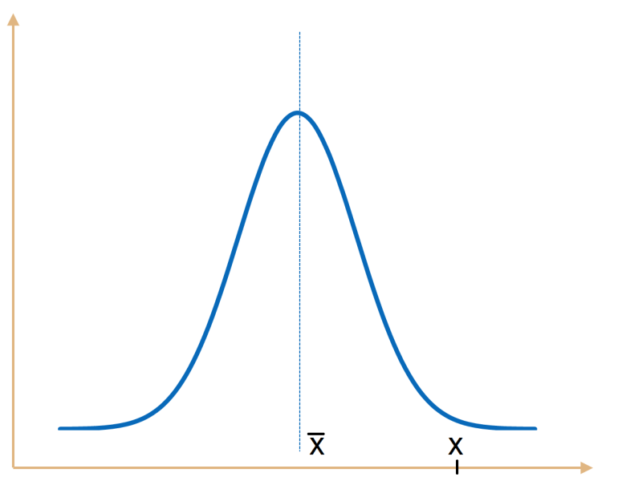
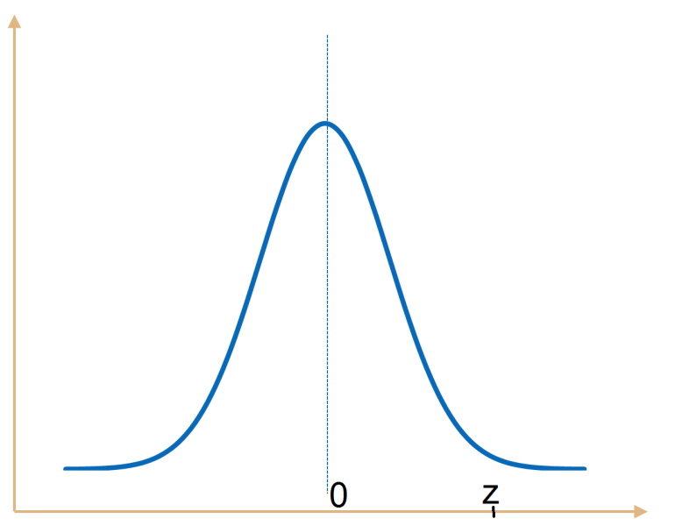
Confidence interval
Any normal distribution can be transformed in a standard normal distribution by using standardization
Standardization changes the mean of the normal distribution of interest to 0 and changes the variance of the normal distribution of interest in 1
Any value from the normal distribution of interest is changed to a z-value from the standard normal distribution

Slide 42
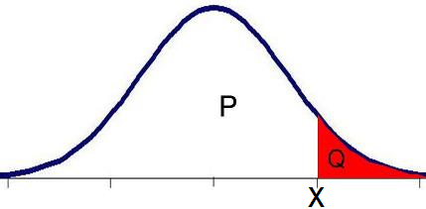
Confidence interval
The correspondence between any normal distribution and standard normal distribution refers to the probability associated with x and its transformation, z.
This means that probability from the normal distribution smaller than x equals the probability from the standard normal distribution smaller than z

Slide 43
Confidence interval
If confidence level is known then α=1-CL
For standard normal distribution the probability corresponding to α is a z that has the same probability α of the standardized x from the actual normal distribution
Therefore, once the z from the standard normal distribution corresponding to α is determined then the corresponding x can be computed:
$$z_{α}=\frac{\overline{x}−μ}{σ_{\overline{x}}}→\overline{x}=μ+z_{α}σ_{\overline{x}}$$
As normal distribution is symmetric and sample means can be larger or smaller than population mean the z corresponding to α can be positive and negative which makes the confidence interval for the sample mean: $μ±z_{α}σ_{\overline{x}}$
Because the population mean is needed and only the sample mean is known the confidence interval for the population mean is expressed as a function of sample mean: $\overline{x}±z_{α}σ_{\overline{x}}$

Slide 44
Confidence interval - example
Mean height of 9 trees and variance 4
Sample mean has 95% probability to be in the interval
Observation: population variance is KNOWN

Slide 45
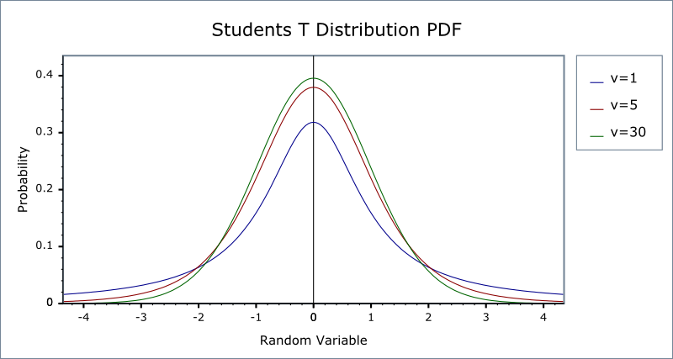
t - distribution
Like the z-distribution:
is bell-shaped
is symmetrical around the mean
mean = mode = median = 0
never touches the X-axis
Different than normal:
Variance >1
t-distribution is a family of curves, each curve
varying as sample sizes change

Slide 46
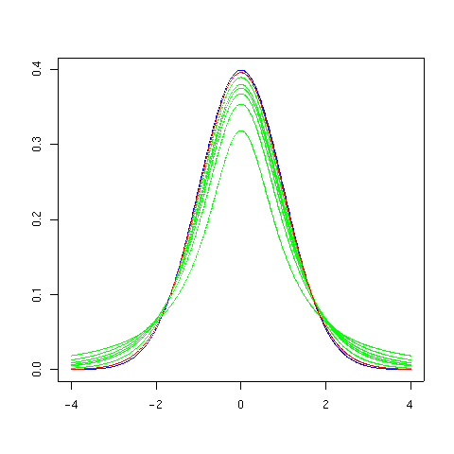
t - distribution
as sample size increases, (especially after n>30), the t-distribution approaches the z-distribution (which can be used in its place)

Slide 47
t - distribution
each curve is described by its “degrees of freedom” which tell us which of the curves we should use for our experiment
degrees of freedom: the number of values free to vary after a sample statistic has been computed
For means: DF = n-1
Sometimes ν or df
Identify which curve (from the t-distribution) to use

Slide 48
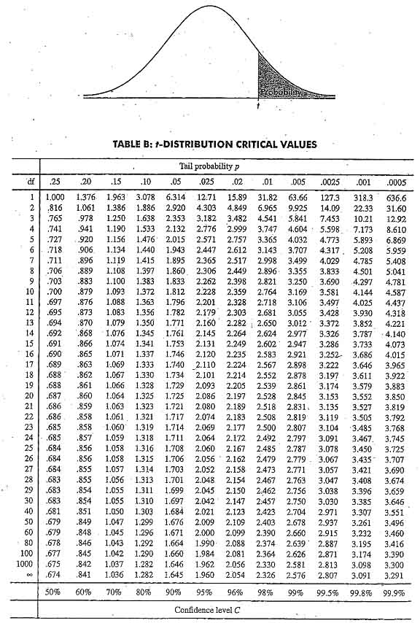
t -distribution

Slide 49
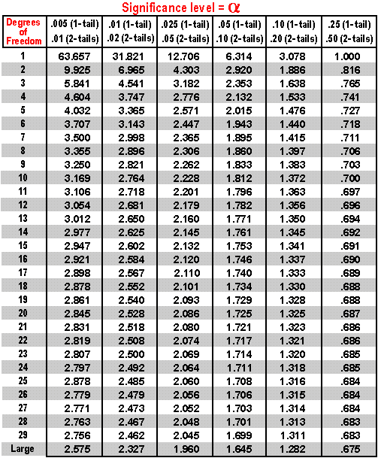
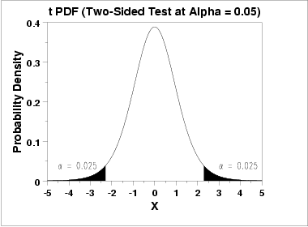
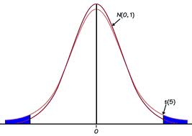
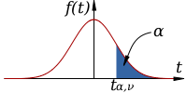
t -distribution

Slide 50
usage of t - distribution
t-distribution used as standard normal distribution
z-transformation (normalization) → t- transformation

Slide 51
General formula - CI mean
Observations:
variance is not known
if variance known then t_{α/2} = z_{α/2}

Slide 52
Hypotheses Testing

Slide 53
Truths and hypothesis
Statistic answers questions interested in finding truths
we know that truth exists, but its quantification transcends human “abilities”
however, we can reduce uncertainty
we do this with hypothesis testing
Statistical hypothesis: a conjecture about a population parameter.
The conjecture may or may not be true

Slide 54
Statistical hypotheses
two types of hypotheses in statistical problems:
null hypothesis (H₀): states that there is no difference between a parameter and some assigned value
alternative hypothesis (H₁or H_{a}): states the opposite, namely that there is a difference between the parameter and assigned value

Slide 55
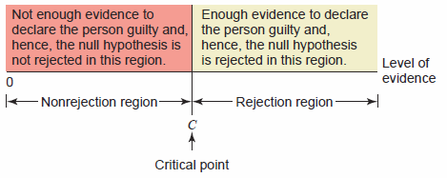
Rejection – nonrejection regions
A trial with the outcome: guilty and not guilty
Let symbolize the amount of evidence for guilt on the x-axis, assuming that no evidence is 0 and as further we go on the axis as larger the amount of evidence is
At a certain point there is enough evidence to declare the person guilty: CRITICAL POINT
Critical point separate the outcomes in two regions: accept H0 or reject H0: CRITICAL REGIONS

Slide 56
Hypothesis testing outcomes
In hypothesis testing there are 4 possible outcomes
Hypothesis/Outcome | H₀ True | H₀ False
Reject H₀ | Error TYPE I | Correct decision
Do not reject H₀ | Correct Decision | Error TYPE II
Type I: Reject null hypothesis when true
Type II: Do not reject hypothesis when false

Slide 57
Significance level and Power of the test
Test: a numerical based assessment of hypotheses
Significance level of a test represents the probability of committing a Type I error
$$α=P\left(H0 is rejected \right|H0 is true)$$
Ex: punishing an innocent person
in general preset
Power of the test represents the probability of committing a Type II error
$$β=P\left(H0 is not rejected | H0 is false\right)$$
Ex: setting a guilty person free

Slide 58
Hypothesis testing outcomes
Example: A patient is going to the physician. The physician is consulting the patient and have to make a decision:
H₀: The patient is sick
H₁: The patient is not sick
If the patient is found not sick (healthy) when in fact was sick then a Type I error was committed.
If the patient was found sick then the correct decision was made.
However, if the patient was found sick but in fact was healthy, then a Type II error was committed.

Slide 59
Hypothesis Testing & Decision Making
statistical tests: use data obtained from a sample to make decisions about whether a null hypothesis should be accepted or rejected
Steps in hypothesis testing using critical values
set up hypotheses and draw a picture
choose an appropriate level of significance
find critical value
take sample and compute test statistic
make decision
draw conclusions

Slide 60
1. set up hypotheses
generally, H₀ incorporates an equality (=, ≥, ≤,), while H₁ does not (≠, >, <)
the signs used determine the type of test that will be performed...
H₀: μ = ? H₀: μ = ?
H₁: μ > ? H₁: μ < ?
1 – tailed right test 1 – tailed left test
H₀: μ = ?
H₁: μ ≠ ?
2 – tailed test

Slide 61
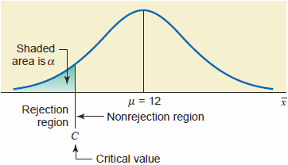
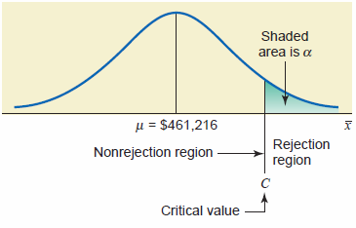
1. Tails of a test
Tails of a test identify the location of critical value and critical regions
H0: The mean amount of Coca can is 12 fl. oz.
H1: The mean amount of Coca is <12 fl. oz.
H0: $μ=12$
H1: $μ<12$
H0: The mean house price is $461,261
H1: The man house price is >$461,261
H0: $μ=461,261$
H1: $μ>461,261$

Slide 62
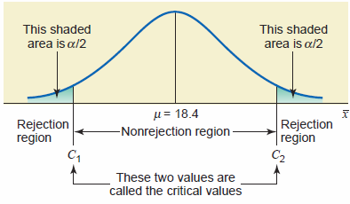
1. Tails of a test
H0: The mean weight of backpacks for sixth-graders in New York has not changed since 2008, that is, currently $μ=18.4 lb$
The mean weight of backpacks for sixth-graders in New York has changed since 2008, that is, currently $μ≠18.4 lb$

Slide 63
2. choose a level of significance
in statistical tests, a decision to accept or reject a null hypothesis is based on values obtained from sampling (sample statistics)
how do we know when to accept or reject a null hypothesis?
it is based on the level of significance that we set up and the associated cut-off point...

Slide 64
2. Level of significance
the decision to reject or accept a hypothesis does not prove anything - our decision is based on probabilities
in other words, when there is a large enough difference between a sample statistic (e.g., sample mean) and a population parameter (e.g., population mean), the null hypothesis is likely not true
the magnitude of this difference depends on the ‘level of significance’ – α: the maximum probability of committing Type I Error (rejecting H₀ when true)
in general, α = 0.05, 0.01, 0.10

Slide 65
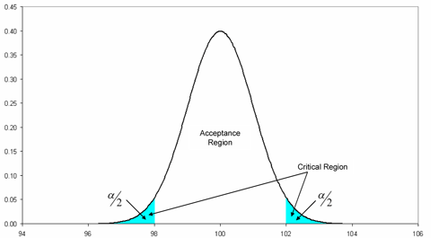
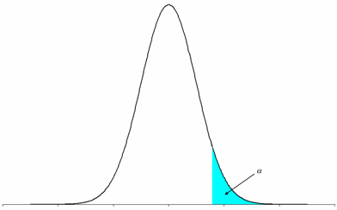
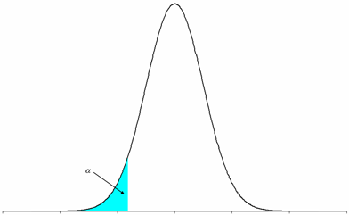
3. find critical value
Critical value: value that separates the critical from the non-critical regions
differences in values in the non-critical region are due to chance (sampling error) and the null hypothesis should be accepted
values in the critical region are “significantly different” from the hypothesized population parameter and the null hypothesis should be rejected

Slide 66
3. Critical values
Depends on at least three factors:
The parameter of interest
Mean
Variance
The level of significance: α
Knowledge regarding either the population or the sample size
For means: the critical values can be computed using z-test or t-test

Slide 67
4. Sample & compute the test
Take a sample from the population
Compute the test statistics
Use z or t distribution for means
Use χ² distribution for variance
Use F distribution for ratio of variances

Slide 68
5. make decision
does the test statistic fall into the critical region?
if yes → reject the null hypothesis (H₀) in favor of the alternative hypothesis (H₁)
if no → accept the null hypothesis (H₀)

Slide 69
6. Draw conclusions
State the decision made in statistical terms using the real problem formulation
Remember: hypothesis testing does not prove causality

Slide 70
Notes:
Thank you for your attention.

